Slide 1
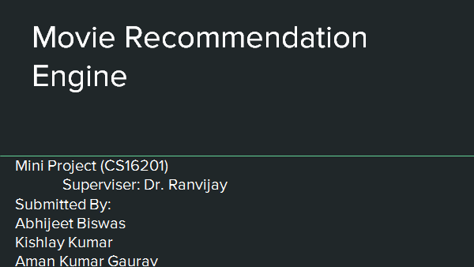
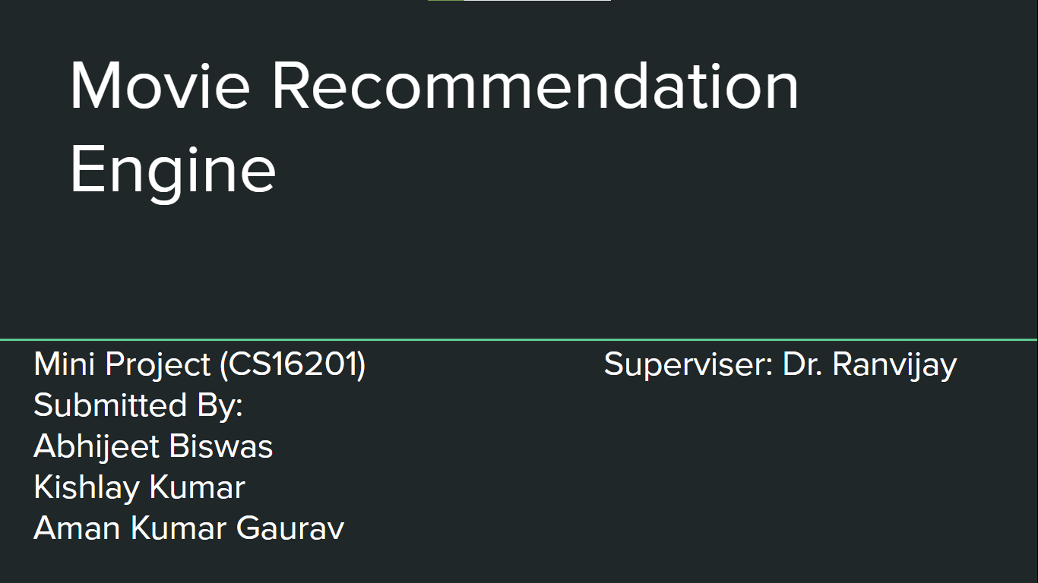
Movie Recommendation
Engine
Mini Project (CS16201) Superviser: Dr. Ranvijay
Submitted By:
Abhijeet Biswas
Kishlay Kumar
Aman Kumar Gaurav

Slide 2
Table of Contents
Introduction
Recommender System Approaches
The Dataset
Popularity Based Recommender System
Content Based Recommender System
Collaborative Filtering Based Recommender System
Future Works
References

Slide 3
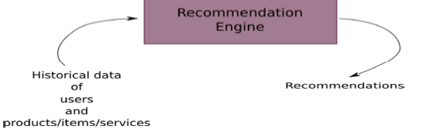
Introduction
A recommendation system is any system that automatically suggests content,
products or services which should interest customers based on their
preferences.
A recommender system uses historical data of user and items/services to
generate a ranked list of recommendations to a user.
The aim is to increase click through rate and dwell time of users.

Slide 4
Recommender System Approaches
Popularity based recommender system
Simple approach make recommendations based on popularity and ratings
Idea : Popular and highly rated movies are more likely to be liked by other users
Content based recommender system
it analyzes the contents (properties of the product etc.) of the product and calculates products with similar features.

Slide 5
Collaborative filtering
Maintains a database of users ratings on various items
Based on these ratings, captures the inherent bias based on taste among users
Almost all existing commercial websites use this approach (eg. Amazon, Facebook, LinkedIn, etc.)
Two subtypes:
User-User CF: “Users who are similar to you also liked …”
Item-Item CF: “Users who liked this item also liked …”

Slide 6
The Dataset
MovieLens Dataset
25M dataset for the Popularity based Recommender and 100K dataset for rest approaches
For 45K movies between January 09, 1995 and October 16, 2016

Slide 7
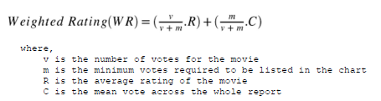
Popularity Based Recommender
Created a chart of movies based on popularity and ratings
Took top 5% most popular movies to capture popularity
Sorted them based on weighted average rating to capture ratings.

Slide 8
Content Based Recommender
Used the tagline, genre, overview, cast, directors, and
keywords associated with a movie to create a document vector of words that described the movies.
Removed stop words and used Stemmer on tagline and overview and keywords.
Calculated similarity matrix between the movies
Used cosine similarity as our similarity measure

Slide 9
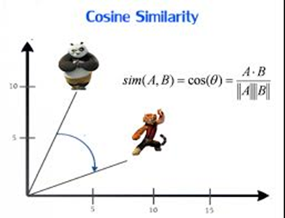
Cosine Similarity:
A commonly used approach to match similar documents is based on counting the maximum number of common words between the document

Slide 10
Disadvantages
1. Cannot filter items on some assessment of quality, style or viewpoint
because of lack of consideration of other people’s experience.
2. Absence of personal recommendations.

Slide 11
Collaborative Filtering Based Recommender
For these recommenders also we used the similar classical approach of
similarity metrics
We used the user ratings data to create a user X movie matrix of ratings
Removed movies and users with no ratings
Item – Item CF: Calculated similarity matrix between user taking movie ratings as feature
User – User CF: Calculated similarity matrix between movies taking user ratings as feature
Similarity Measure: Cosine Similarity not suitable. We used PCS

Slide 12
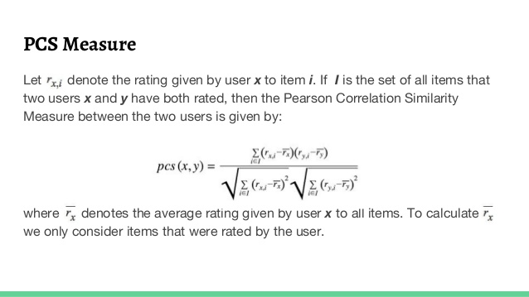

Slide 13
Disadvantages
1. Cold Start: There needs to be enough other users already in the system to find a match.
2. Sparsity: Most users do not rate most items and hence the user-item matrix is typically very sparse. It is hard to find users that have rated the same items.
3. First Rater: It is not possible to recommend an item that has not been previously rated. This problem comes for new items mostly.

Slide 14
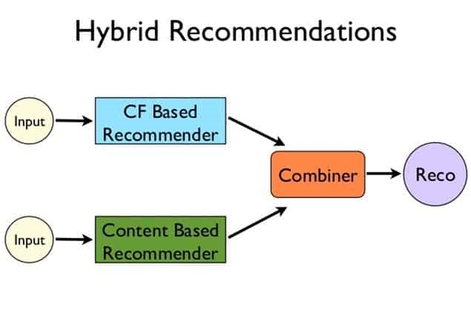
Hybrid Approach

Slide 15
Future Work
We can implement a popular model-based matrix factorization approach
which is scalable and is suitable for dynamically changing data.
We can use Clustering Algorithms like K-Means to cluster items or users or both based on their attributes.
We can also implement the Hybrid approach.

Slide 16
References
1. https://grouplens.org/datasets/movielens/100k/ - MovieLens Dataset.
2. https://pdfs.semanticscholar.org/1356/f4eda338b58b2840c5f643a988a10088
06f0.pdf - Machine Learning Based Hybrid Recommendation System
Thanks

